Slide 1
Mobile Application Support For Eating Disorder

Slide 2
Aim, Objective and Scope
Create a IOS mobile application that will provide an easier experience for primary caregivers and people with eating disorder to record their dietary information for the day which can also be sent to their therapist or doctor.
Research about similar apps and other information such as a consent form or waver
Develop a user friendly IOS mobile application that can send the gathered information from the user.
Add a feature to the application that records meal information such as time, food, photos, notes
Add a consent form that the user must agree first before using the application

Slide 3
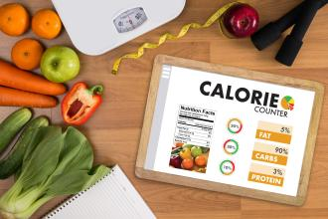
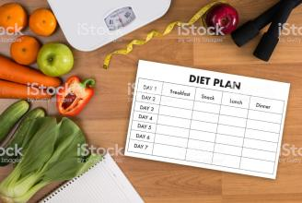
Project Description and Deliverables
Opportunity to create a user friendly mobile application for the mental health community specifically people with eating disorder which can aid them in logging or recording information that are needed by their therapist or doctor.
Research Question
Can we make a simple way to help people with an eating disorder to be able to record their dietary information through an app and be to send the information to therapist/doctor when necessary?
Retrieved from: https://www.thedelite.com/wp-content/uploads/2019/04/AdobeStock_157256074.jpeg
Retrieved from: https://media.istockphoto.com/photos/healthy-eating-dieting-slimming-and-weigh-loss-concept-picture-id649385722

Slide 4

Added Values, MOV and Areas of Impact
Personal and Societal Impact
Mental Health Awareness
Accessibility for people with eating disorder
Gain 300 downloads on the first quarter
Retrieved from: https://cook.fnr.sndimg.com/content/dam/images/cook/fullset/2013/11/4/0/CCDevour_brain-foods_s4x3.jpg.rend.hgtvcom.1280.960.suffix/1383595401673.jpeg

Slide 5


Functionalities and Platform to use
Xcode by Apple
Retrived from: https://is3-ssl.mzstatic.com/image/thumb/Purple123/v4/5b/85/cb/5b85cb0f-a976-3f41-0b78-f314fbea19de/Xcode-0-85-220-0-0-0-0-4-0-0-0-2x-sRGB-0-0-0.png/1200x630bb.png
Functionalities
Log form to record meals at different time of the day
View previous log entries
Export record to a pdf file
Retrieved from: https://klima.hu/wp-content/uploads/2018/06/PDF-pic.png

Slide 6
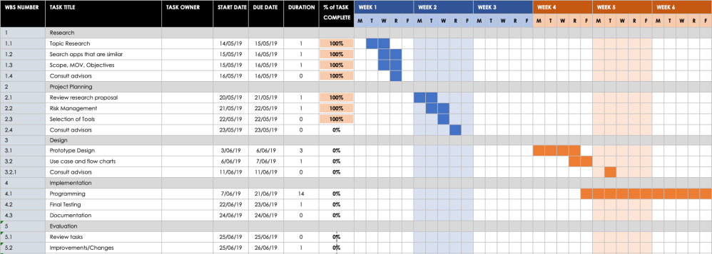
Gantt Chart

Slide 7
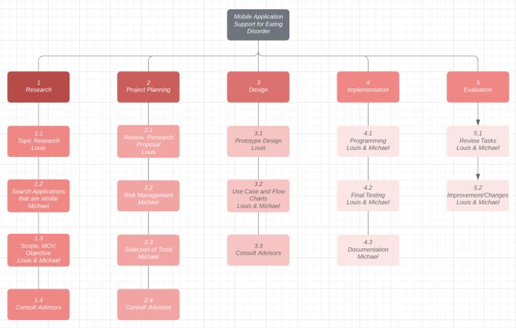
Work Breakdown Structure

Slide 8
Risks and Mitigation
Risk | Mitigation
Hardware failure | Mitigate risks by creating backups and save files often.
Lack of communication | Mitigate risks by setting up meeting dates to update each other by having meeting with each other and have contact information
Inexperience in mobile application development | Research on the platform we are using and making sure we know fundamentals. Use guides to help.
Time Constraints | Have leeway days for certain tasks so we have time to make up for it if certain situations occur where we need them.

Slide 9
Questions?

